Slide 1



EMSE 6586 : Airline Analysis: Exploring Operational Performance and Trends
-Aparna Shankar (G49628466)
April 29, 2024

Slide 2

Overview
Introduction
Objective
Dataset Description
Technologies used
Workflow
Entity Relationship Diagram
Overview of tables
Analysis and Results
Conclusion
References
03
04
05
06
07
08
09
10
14
15

Slide 3
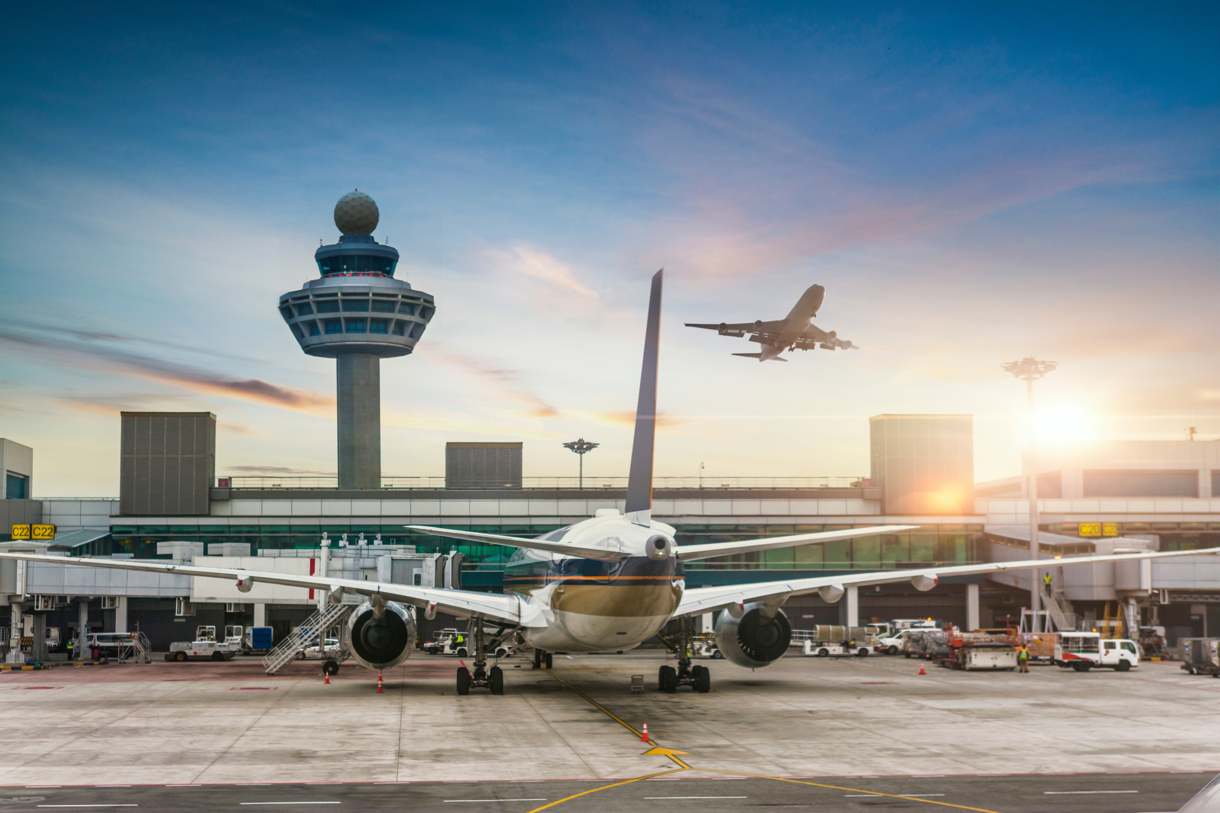


Introduction
The aviation industry generates vast amounts of data ranging from flight schedules and performance metrics to airport operations and passenger information.
Through SQL queries and analytics, this project delves into various aspects of airline operations, including flight delays, airport performance, carrier distribution, and trends over time.

Slide 4
Objective
DATABASE TRANSLATION
The aim of this project is to convert a JSON dataset, into a format conducive for storage and analysis within a relational database
By transforming the airlines data into a more organized SQL database, we enable comprehensive analysis, offering airlines, airports, and aviation authorities valuable insights.

Slide 5
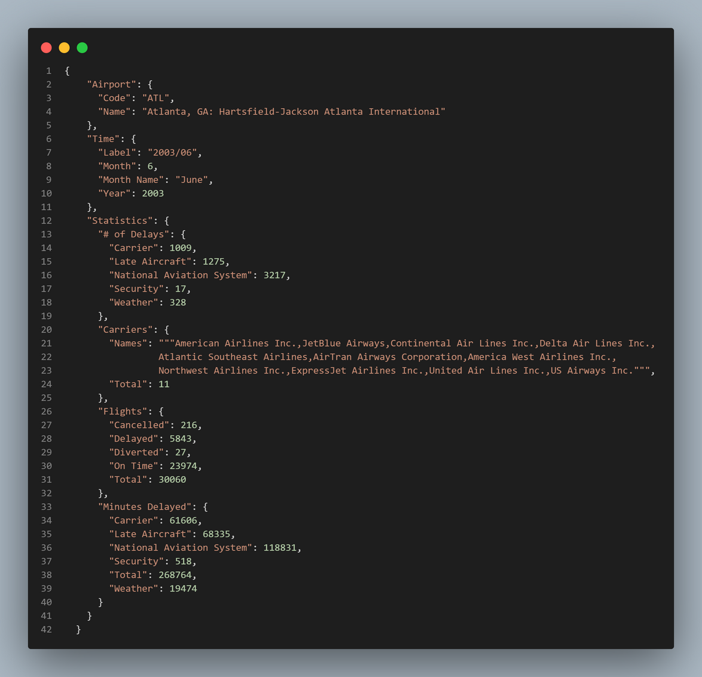
Dataset Description
This dataset contains detailed statistics related to airlines, including flight delays by various factors, no of cancellations, diversions, and on-time performance, organized by airport codes, months, and years.
Restructuring the JSON data into three separate tables (Time, Airport, and Statistics) helps in simplifying and organizing the data, making it more suitable for analysis in SQL.
SQL tables are created for each identified entity, based on the attributes present in the JSON data.
1. Airport Table: Contains the columns Code and Name of the airport
2. Time Table: Includes columns such as Label, Month, Month Name, and Year.
3. Statistics Table: Contains columns for various statistics like No. of Delays, Carriers, and Flights, along with their respective attributes.
Sample JSON data

Slide 6






Technologies Used
Overview of the key technologies and resources used and their roles in contribution to the project’s execution.
01
02
03
04
Python Programming Language
PostgreSQL Database
Visual Studio Code
Version Control
GitHub for efficient collaboration, change tracking, and backup of project progress
To perform data transformaton tasks for SQL ingestion and Visualization analysis.
Relational Database for storage and querying of data
IDE used for writing and executing SQL queries

Slide 7
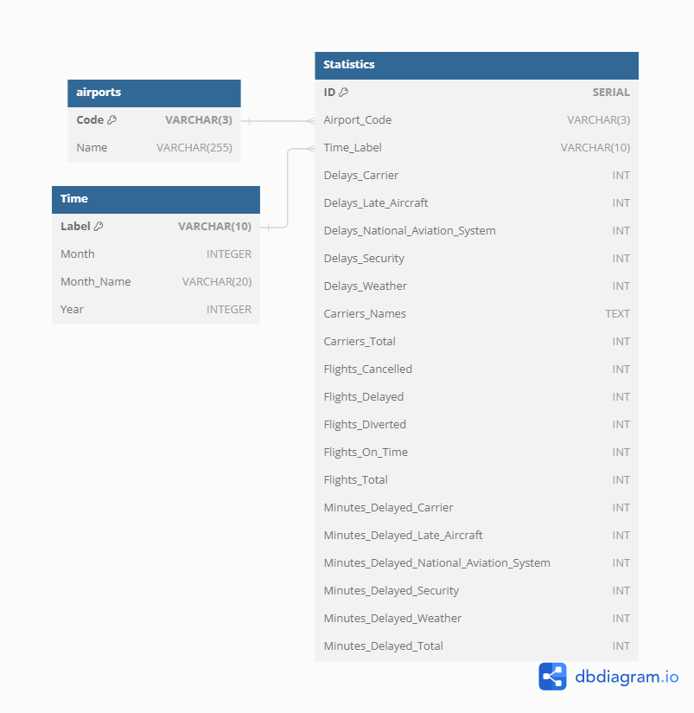
ENTITY RELATIONSHIP DIAGRAM
The relationships between the tables are established using foreign keys to determine the appropriate relationships :
- The Statistics table has a foreign key referencing the Time table using time_label field to link each statistic entry to a specific time period (One-to-Many).
- Similarly, the Statistics table has a foreign key referencing the Airport table using the attribute airport_code to associate each statistic with a specific airport (One-to-Many).

Slide 8




FETCH JSON DATA FROM URL
Retrieve JSON data from a provided URL using Python's requests library and write into a JSON file.
WORKFLOW
DATABASE CREATION
The Database translation involves a streamlined workflow from the process of data retrieval into a structured SQL database to perform analysis through queries and visualizing the insights obtained from the data.
Establish a connection to a PostgreSQL database using psycopg2 and creates a new database named "mydb". Define the schema, including table names, column names, and data types
INSERTION OF DATA TO SQL TABLES
Insert the parsed data into the respective tables in the database by iterating through each records.
QUERY ANALYSIS AND VISUALIZATION
Perform analysis by executing SQL queries to retrieve and manipulate the data by means of filtering, Joins, aggregation etc and visualize the results.

Slide 9
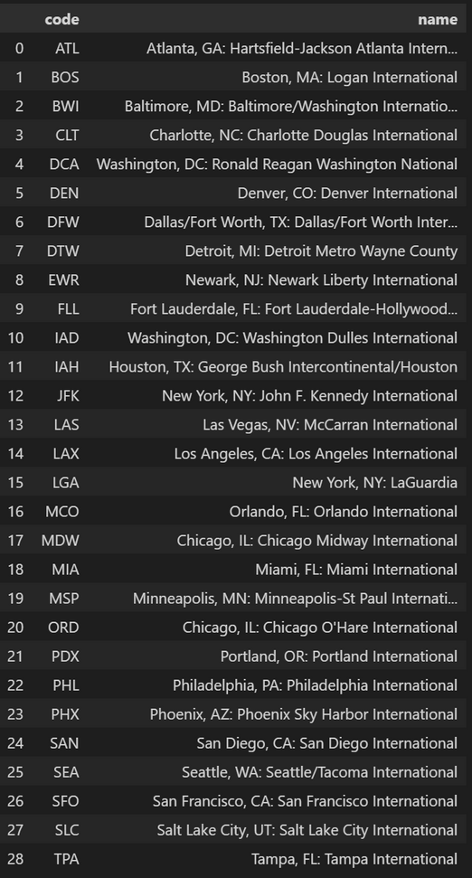
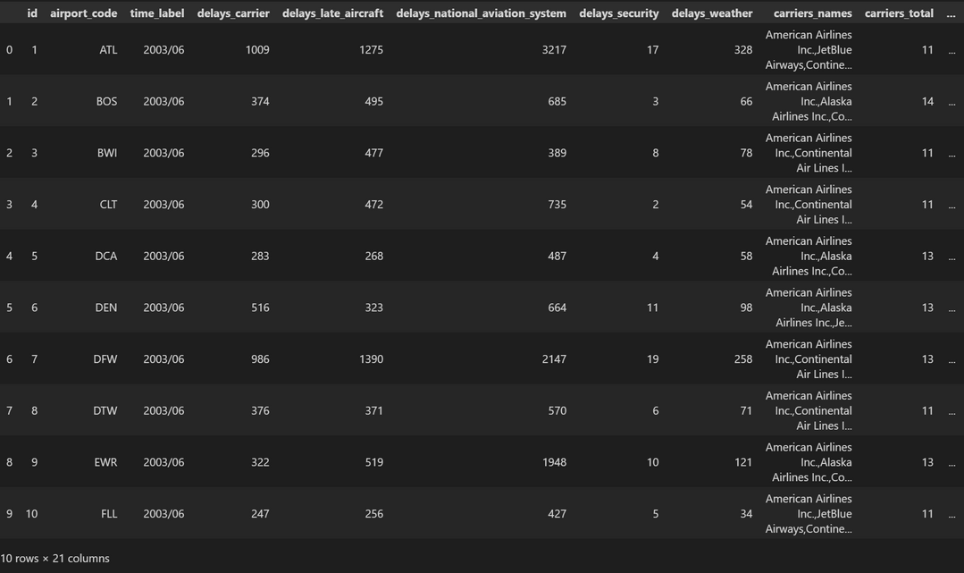
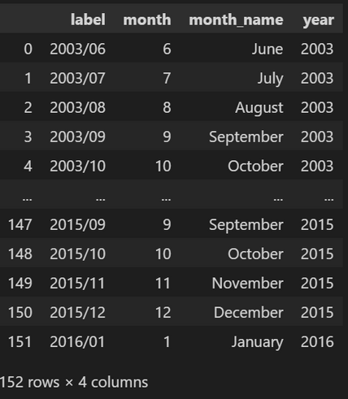
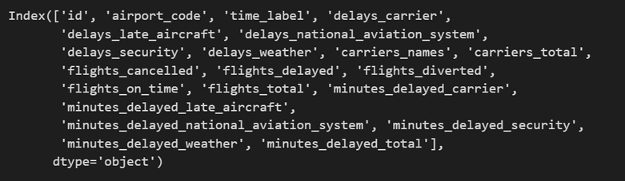
OVERVIEW OF TABLES
Time Table
Statistics Table
Airports Table

Slide 10

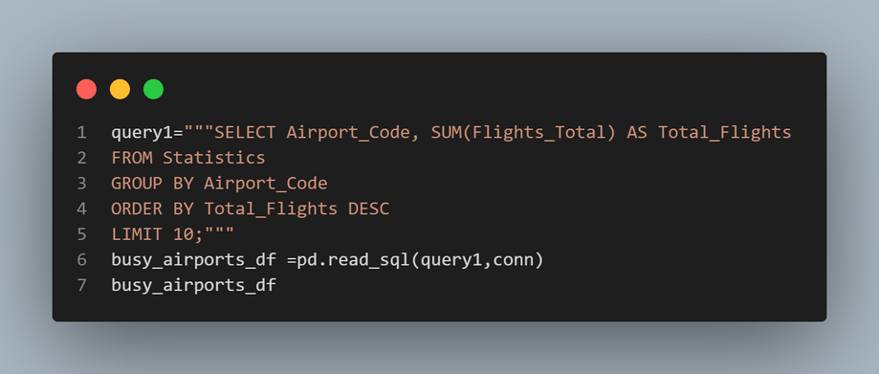
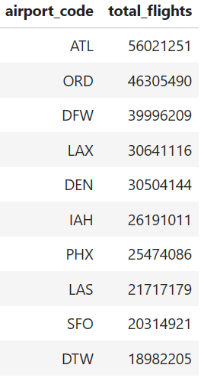

Analysis and Results
Busiest operating airports
This query summarizes the total number of flights for each airport, ranking them by flight volume to identify the top 10 busiest airports.
Hartsfield-Jackson Atlanta International Airport (ATL) is the busiest airport by a significant margin, with over 50 million total flights.

Slide 11
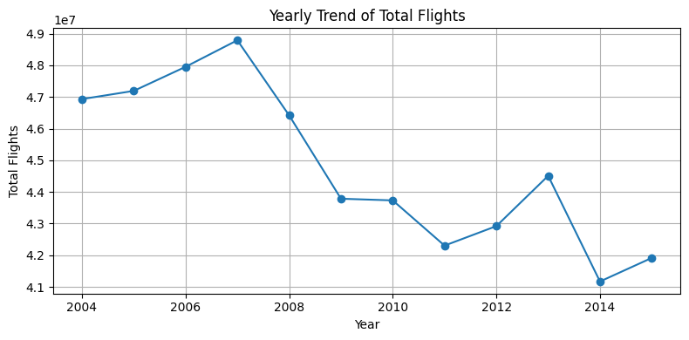
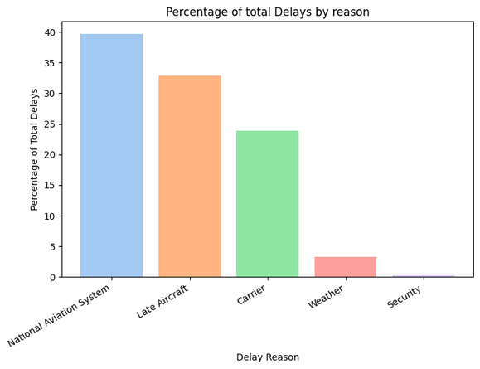
Analysis and Results
Trend of total no of flights operating over different years
The line plot analyzes the yearly trend of total flights operated each year, indicating a rise from 2004 to 2007, followed by a gradual decline until about 2012. The decline in total flights after the slight increase in 2012-2013 highlights how the aviation industry can be unpredictable and subject to change.
Most common reasons for flight delays
Flight delays attributed to five distinct reasons are recorded in the Statistics table individually. The analysis reveals that issues with the National Aviation System and late aircraft arrivals are the primary contributors to flight delays, followed by delays attributed to the carrier itself. Weather-related delays and security-related issues have a comparatively smaller impact on overall flight delays.
Analyzes the trend of total flights operated each year,between the years 2004 and 2015. It provides insights into the overall growth or decline in flight operations over this period.
- The query aggregates the total number of flights operated, omitting any cancelled flights, by joining the "Statistics" and "Time" tables using the Time label as a foreign key.
- The results are grouped by year and sorted chronologically.

Slide 12
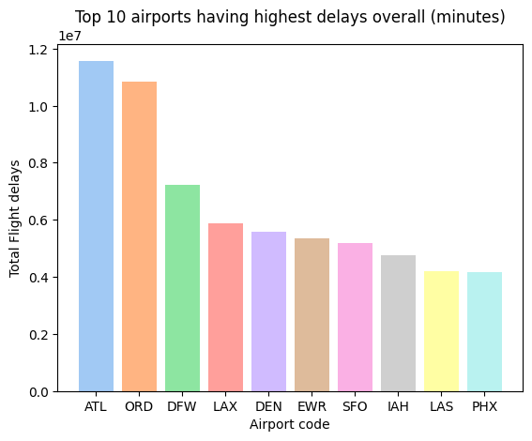
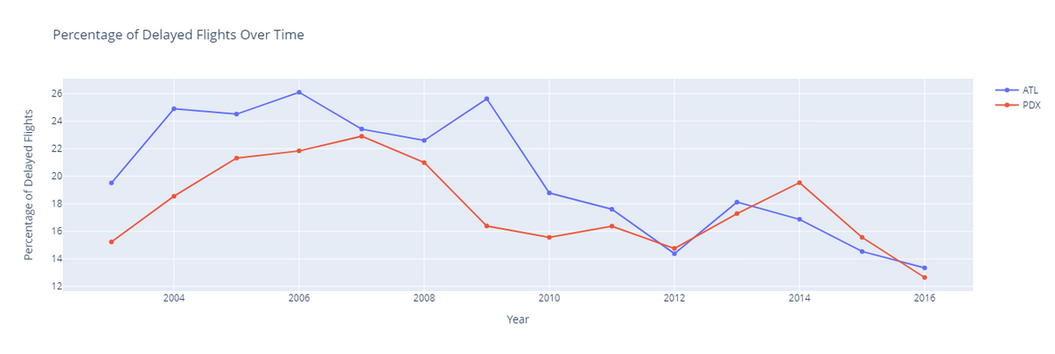
Analysis and Results
Top 10 airports with highest flight delays by time
Airports like ATL , ORD , and DFW have the highest total delayed minutes, suggesting they may face significant challenges in managing flight delays. Conversely, airports like PDX (Portland International) have relatively lower total delayed minutes, indicating better efficiency in managing flight schedules and minimizing delays.
Percentage variation of delayed flights between ATL & PDX
Both ATL and PDX show fluctuating delayed flight percentages over the years, with ATL consistently having higher rates. By 2016, both airports see reductions in delays, with ATL showing a more significant decrease.

Slide 13
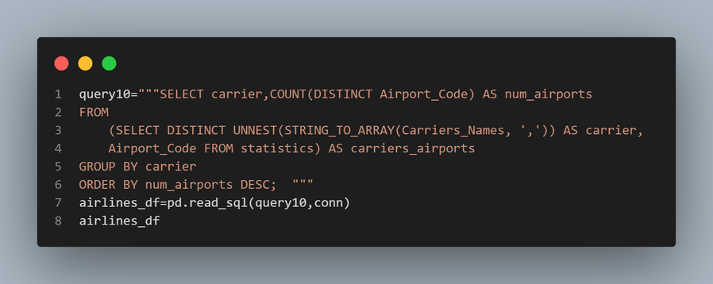
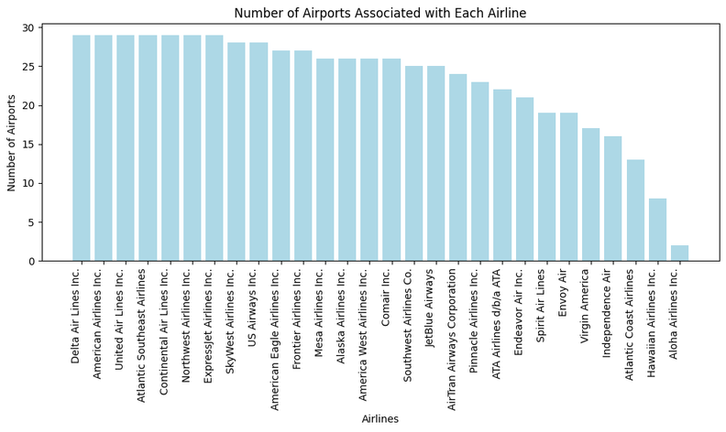
Analysis and Results
Number of airports associated with each airlines
Delta Air Lines Inc., American Airlines Inc., United Air Lines Inc., Atlantic Southeast Airlines, Continental Air Lines Inc., and Northwest Airlines Inc. are the top 6 carriers serving the highest number of airports, each serving 29 airports.
Hawaiian Airlines Inc. and Aloha Airlines Inc. serve the fewest airports, with 8 and 2 respectively.
The competitive landscape of the airline industry can be inferred from the distribution of airports served by different carriers. Some airlines may prioritize serving a wide range of destinations, while others may focus on specific regions or routes.

Slide 14


Conclusion
The project effectively translated a complex nested JSON dataset into a structured SQL database, enabling comprehensive analysis and visualization of crucial aviation metrics.
The data translation process played a crucial role in converting the complex JSON data into a structured format suitable for analysis in a SQL database.
Through this analysis, we can identify areas for improvement to make informed decisions and improve the overall efficiency and safety of air travel, and enhance the overall passenger experience.
Notes:
-Data translation process played a huge role in better comprehension of the dataset to extract meaningful insights from it.
- By analyzing this data, we can identify opportunities to improve the overall efficiency and safety of air travel, ultimately improving the passenger experience.

Slide 15
REFERENCES
https://www.powercms.in/article/how-get-json-data-remote-url-python-script
https://wiki.postgresql.org/wiki/Using_psycopg2_with_PostgreSQL
https://www.commandprompt.com/education/postgresql-union-all-operator-with-examples/#:~:text=In%20Postgres%2C%20the%20UNION%20ALL,same%20number%20of%20expressions%2Fcolumns.
https://community.plotly.com/t/how-to-add-points-on-the-scatter-line-with-plotly-graph-objects/74026
https://www.tutorialspoint.com/sql/sql-string-functions-string-agg.htm
https://count.co/sql-resources/bigquery-standard-sql/unnest
Dataset source:
https://think.cs.vt.edu/corgis/datasets/json/airlines/airlines.json
Complete code:
https://github.com/Aparna003/EMSE_6586_Airlines_analysis

Slide 16


THANK YOU

